Slide 1
Classification of Vertebral Body Fractures
Dr karen billington
Consultant Radiologist, Te whetu ORA Auckland
Musculoskeletal Radiologist, Auckland Radiology Group

Slide 2
Outline
Anatomy
Terminology
Imaging modalities
Measuring fracture height loss
Case examples

Slide 3
Anatomy of the Spine

Slide 4
Anatomy of the Spine

Slide 5
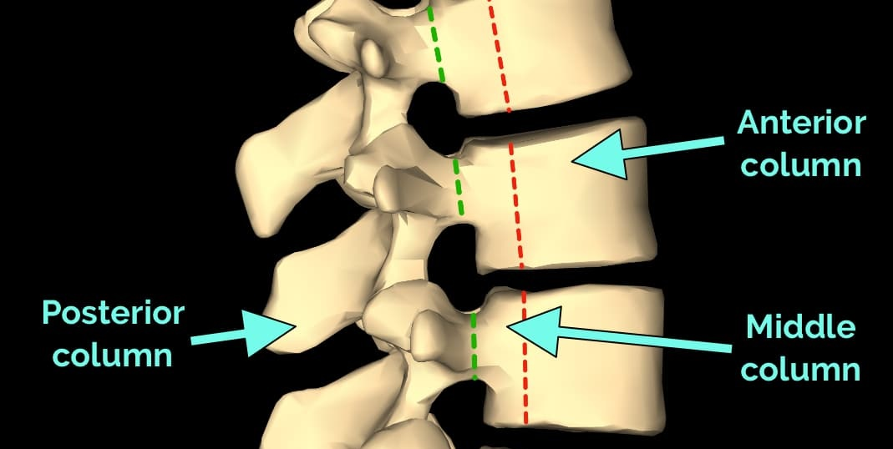

Slide 6
Terminology
Wedge compression fracture
- fracture of the vertebral body involving one endplate but not the posterior wall
Split fracture
- involvement of both endplates but not the posterior wall
Burst fracture
- involvement of one (incomplete) or both (complete) endplates and the posterior wall

Slide 7
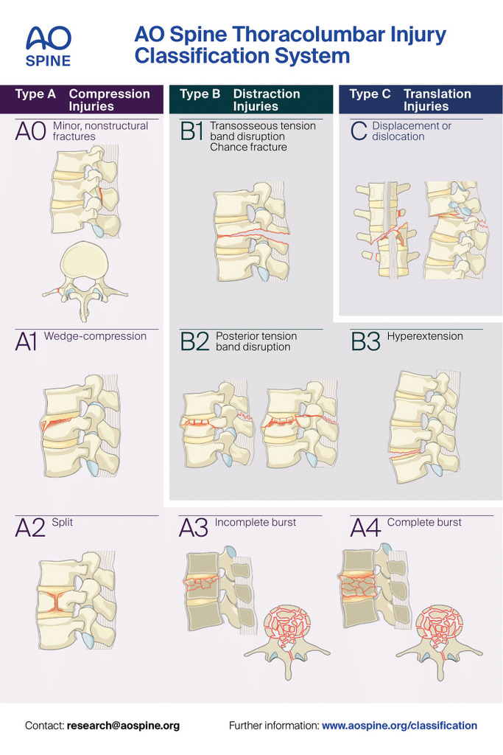
Genant Classification of Vertebral Fractures
Grade 0: normal
Grade 1: mild, <25% loss of height
Grade 2: moderate, 25-40% loss of height
Grade 3: severe, >40% loss of height

Slide 8
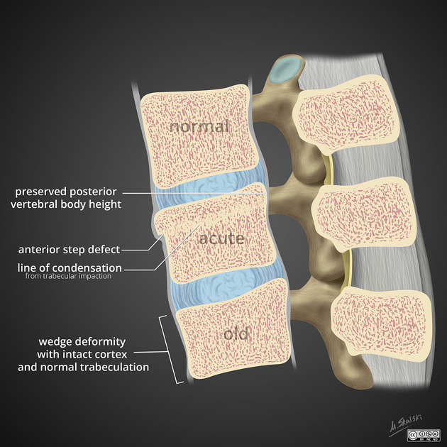
Acute vs chronic
- Clinical history
- Previous imaging
- Cortical disruption
- Trabecular impaction
- MRI: marrow oedema
- Scintigriphy: increased tracer uptake

Slide 9
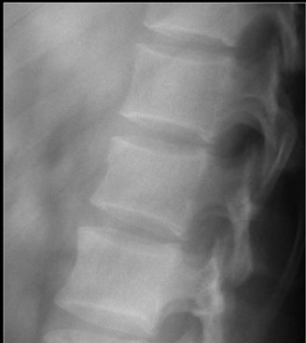
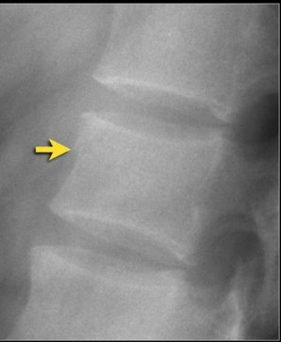

Slide 10
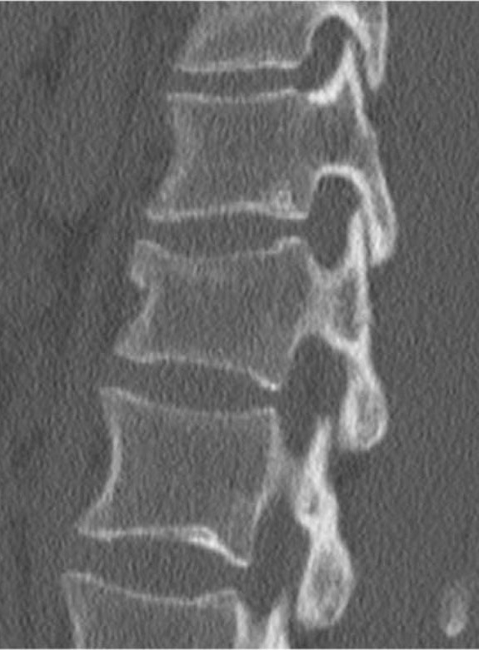
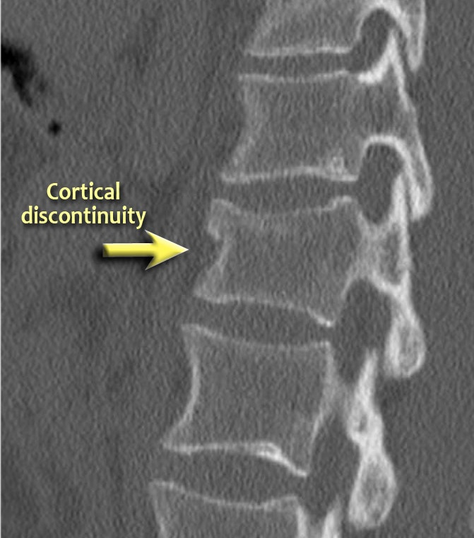

Slide 11
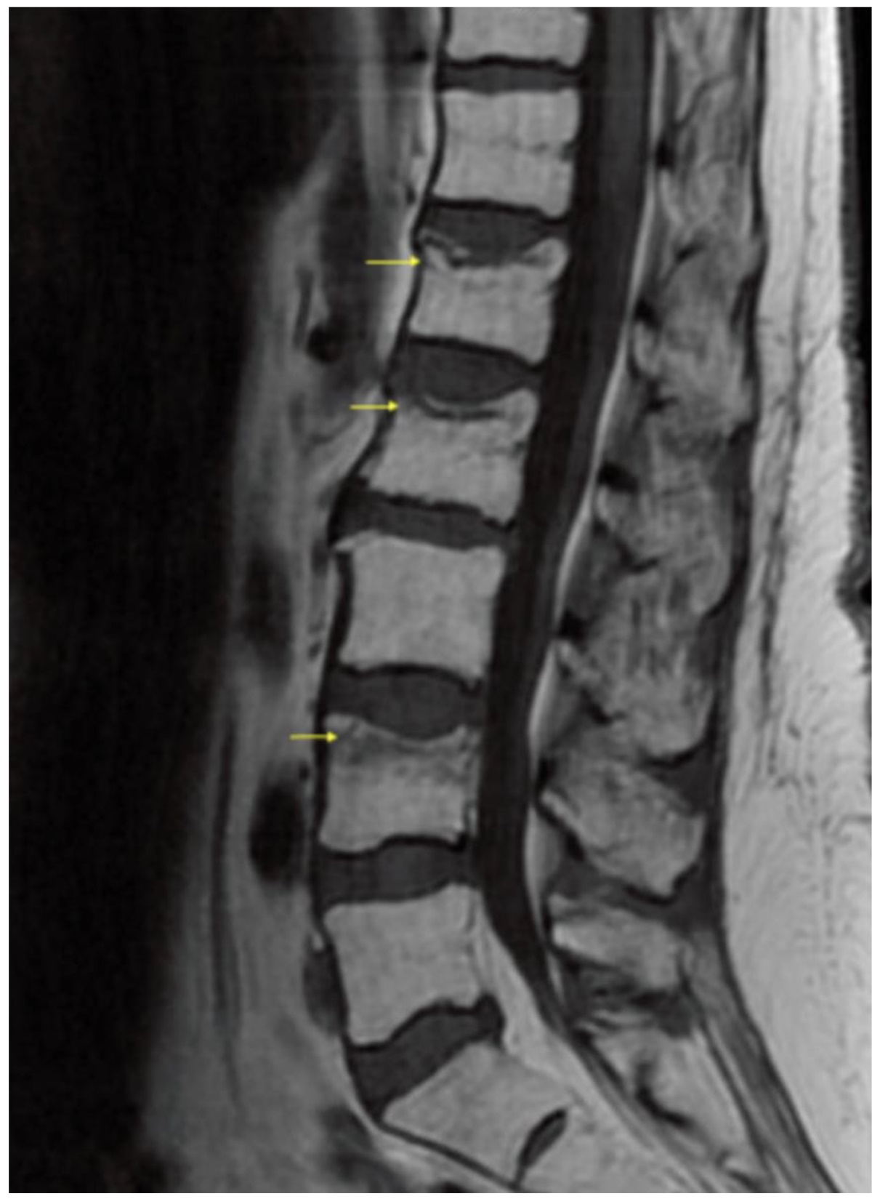
Osteoporotic vs pathological
- no bony destruction
- preserved fatty bone marrow signal on MRI
- low signal band indicating a fracture line
- retropulsion, not posterior bulging
- multiple compression fractures
…favour a benign compression fracture

Slide 12
Radiographs
Inexpensive
Widely available
Quick to perform, therefore well tolerated
Low radiation dose
Limited bony detail, diminished by:
- increased body habitus
- reduced bone density
Difficult to determine chronicity
Limited by patient position

Slide 13
CT
Available out of hours
Takes less than 1 minute
Images can be reformatted in multiple planes and filters (bone, soft tissue, 3D)
No contrast needed
Dual energy CT and SPECT can help determine chronicity
Images can be degraded by movement or breathing
Higher radiation dose than radiographs
Soft tissue detail of cord, epidural space and nerve roots is limited
Can miss subtle fractures if patient is very osteopenic

Slide 14
MRI
Limited out of hours availability
Excellent soft tissue detail
No contrast needed
Can establish chronicity
Can help determine benign vs pathological
No radiation
Images can be degraded by movement or breathing
Takes 20-30 minutes

Slide 15
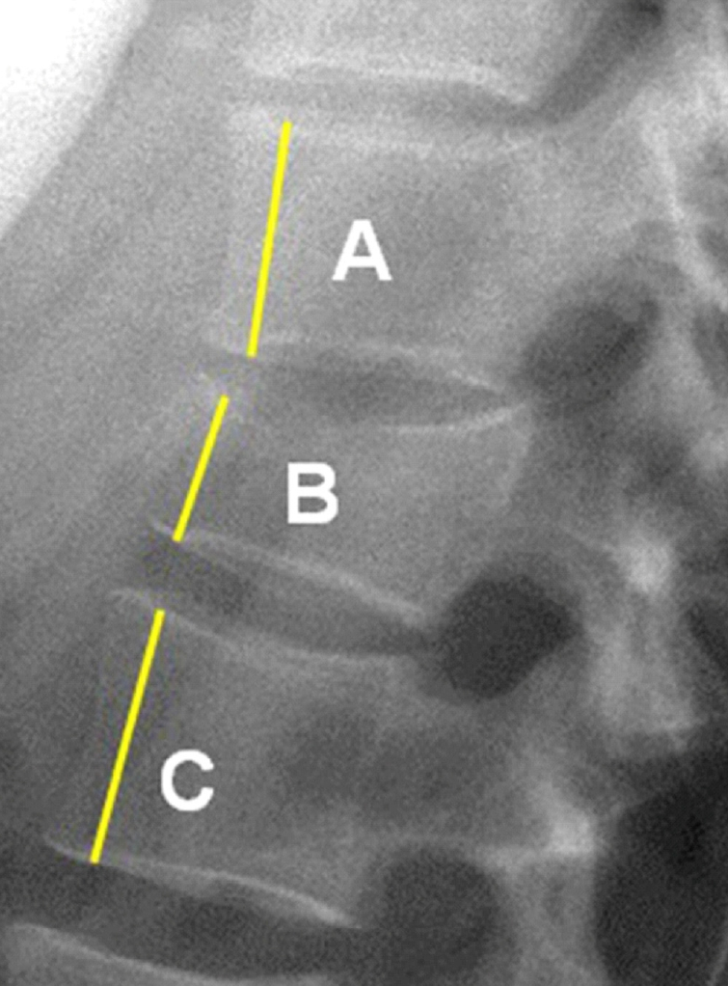
Measuring vertebral body height loss
% vertebral body height loss =
A+C/2 – B x 100
A+C/2

Slide 16
Case examples

Slide 17
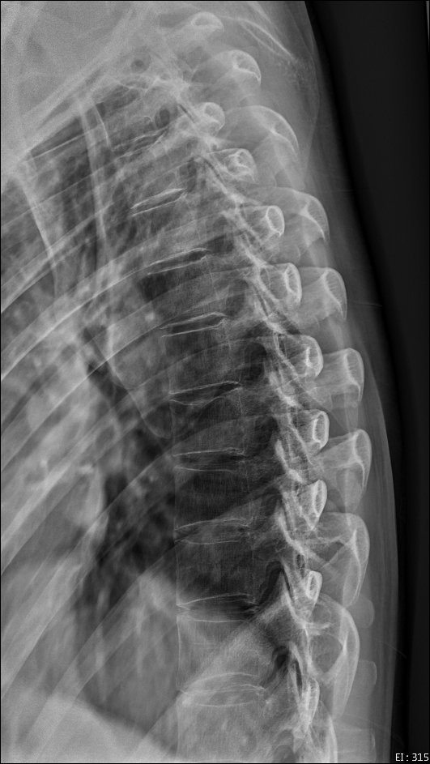
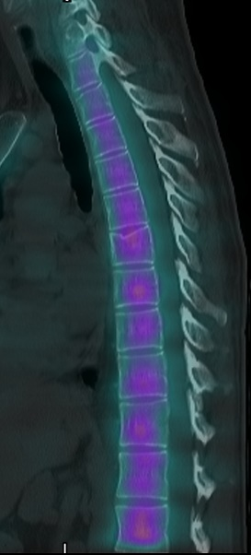
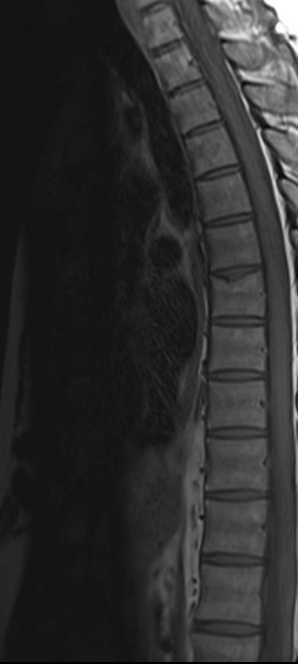
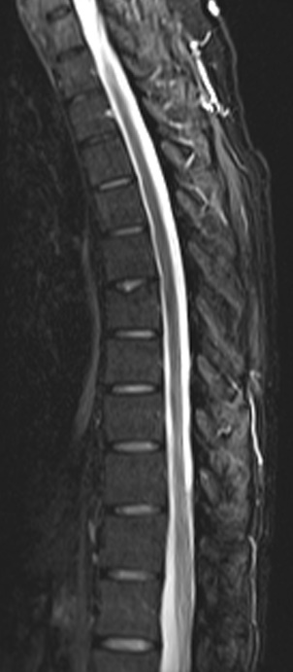

Slide 18
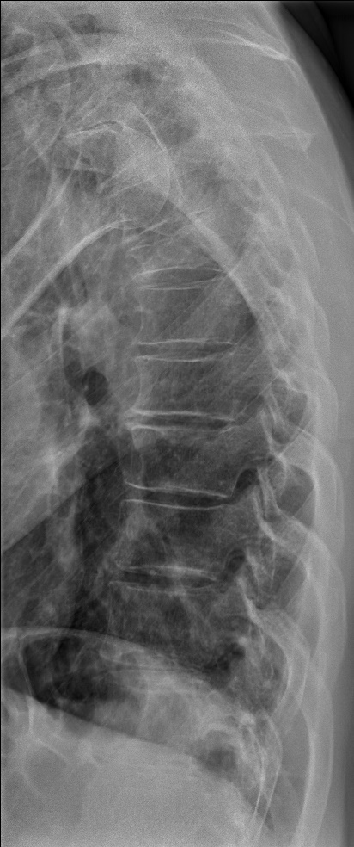
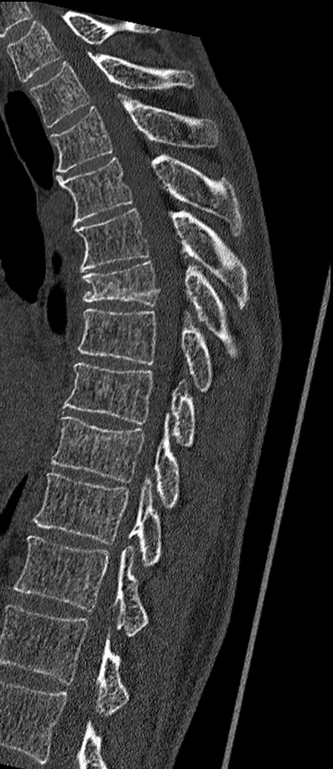
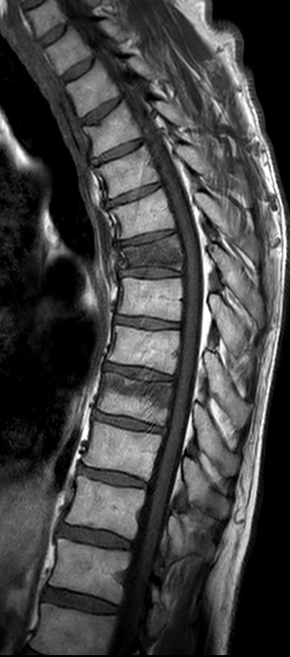
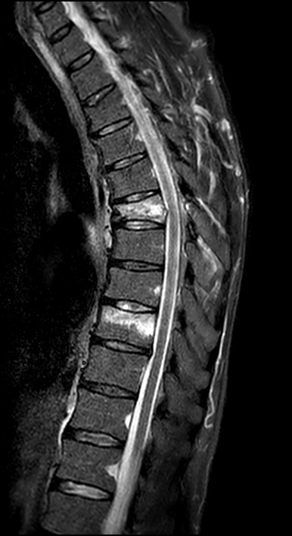

Slide 19
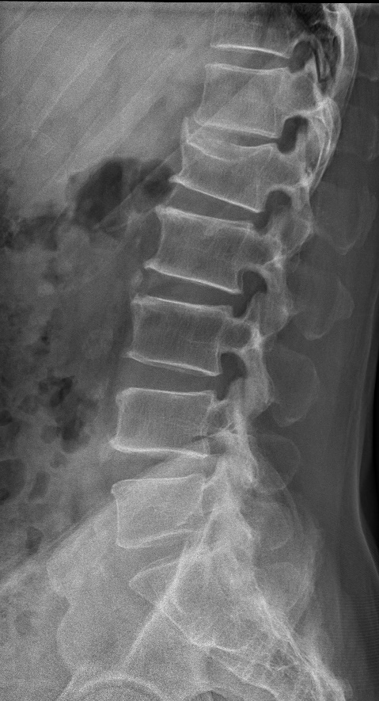
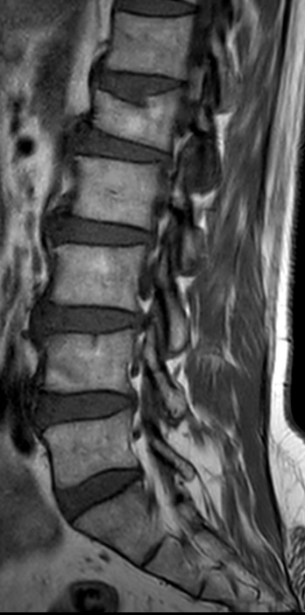
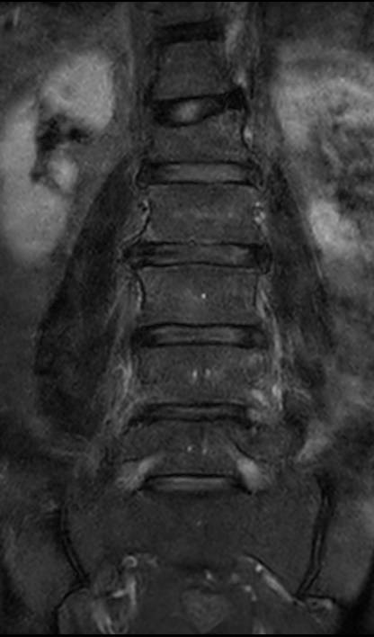

Slide 20
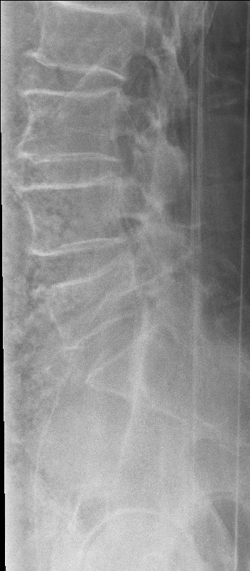
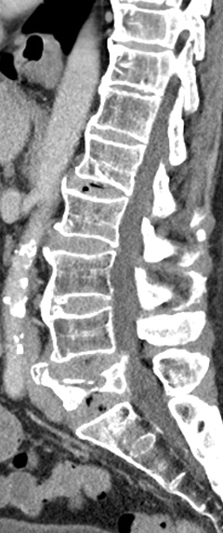
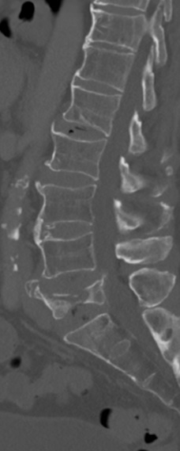
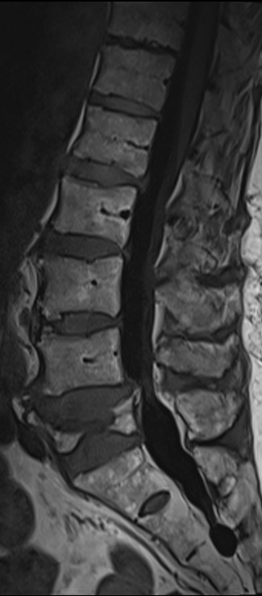
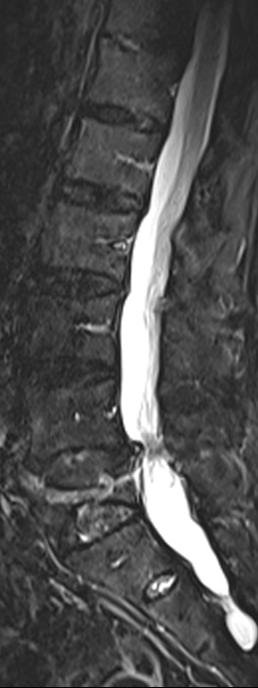

Slide 21
In summary…
Clinical history is critical to help interpret images
Compare with previous imaging
CT and MRI can be used as problem solvers
If unsure, please come speak to a radiologist. We’re happy to help.
Thank you

