Slide 1


Epidemiology of fractures in different ethnic groups across the lifespan in New Zealand
Brya Matthews
University of Auckland

Slide 2
Rationale
Osteoporosis is usually related to aging, but fractures occur and affect people throughout life: useful to understand burden of fracture in all age groups
To determine the frequency of fractures in New Zealand overall and at key sites in different genders and ethnic groups across the lifespan
Aim

Slide 3
Methods
New Zealand Accident Compensation Corporation (ACC) records provided the primary data source
ACC is a national no-fault insurance system, claims should be present for fractures treated in public and private healthcare systems
Individualised claim records for all fracture-related read codes obtained from ACC for 2010-2019. 2019 excluded from final analysis.
Fracture sites identified based on read codes
Demographic data sorted based on age brackets, gender and prioritised ethnicity
Population estimates obtained from Statistics New Zealand

Slide 4
Dataset characteristics
Total claims: 851,544 (9 years)
47.2% female
Notes:
19 claims excluded due to absent or impossible age.
Population – 14% increase
National Minimum Dataset

Slide 5
Dataset characteristics
Total claims: 851,544 (9 years)
47.2% female
Notes:
19 claims excluded due to absent or impossible age.
Population – 14% increase
National Minimum Dataset

Slide 6
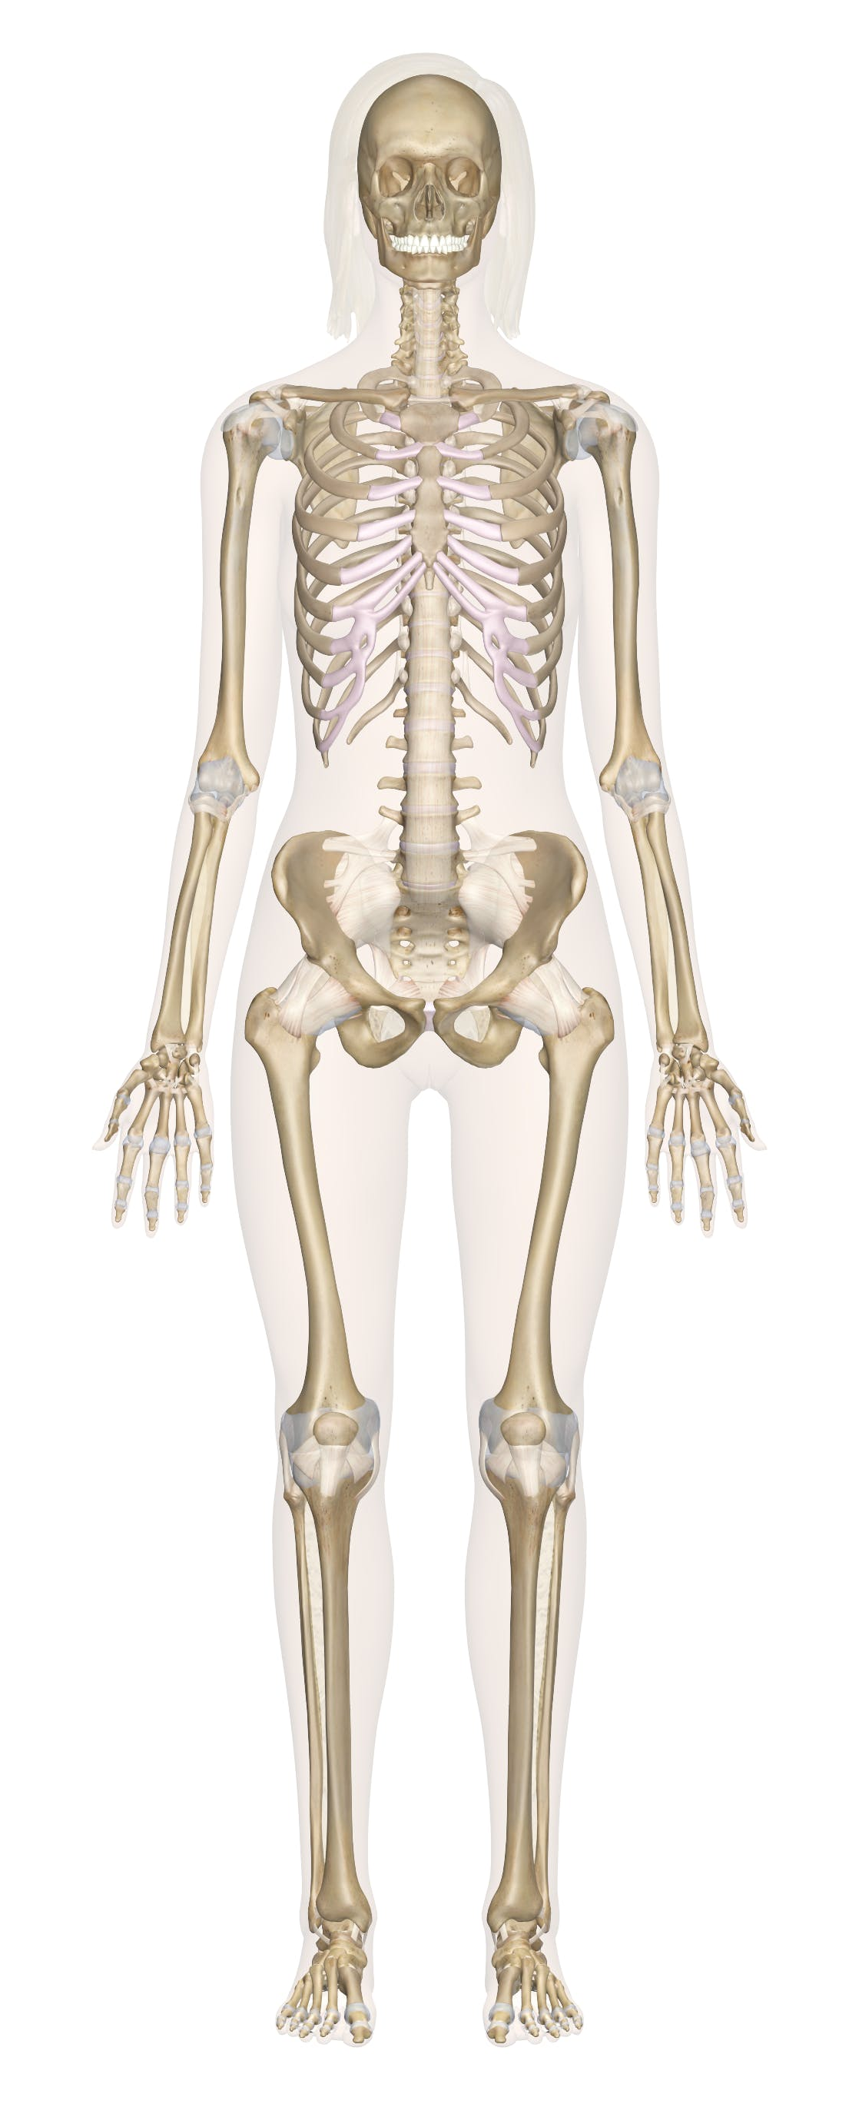
Fracture distribution ALL ages
Aged 80+
Skull/face: 4000/y (4%)
Skull/face: 3%
Ribs: 7500/y (8%)
Ribs: 14%
Upper arm: 9500/y (10%)
Upper arm: 12%
Vertebrae: 5%
Vertebrae: 1600/y (2%)
Forearm: 17,500/y (19%)
Pelvis: 7%
Forearm: 13%
Pelvis: 1500/y (2%)
Hands: 21,000/y (23%)
Hip: 27%
Hands: 6%
Hip: 3000/y (3%)
Lower leg: 12,000/y (12%)
Lower leg: 7%
Feet: 15,000/y (16%)
Feet: 5%

Slide 7
Fracture incidence peaks in adolescence and the elderly

Slide 8
Age-related trends depend on fracture site

Slide 9
Ethnicity distribution is similar to the NZ population
Priority
1
2
3
4
5
Notes:
Prioritised ethnicity
98% with ethnicity stated
Combine European with other for remaining analysis,
Other over-represented

Slide 10
Europeans have higher fracture rates than other ethnicities
All Fractures
Female
Male
Notes:
Europeans, shown in black, consistently have higher fracture rates than the other ethnic groups
Māori and Pacific people – overall about 2/3 the rate in Europeans (Māori generally a little higher than Pacific)
Asian – less than half the rate in Europeans, ratio is 0.36

Slide 11
Europeans have higher fracture rates than other ethnicities
Hip Vertebrae Arm Lower Leg
Female
Male
Notes:
Europeans, shown in black, consistently have higher fracture rates than the other ethnic groups
Māori and Pacific people

Slide 12
Fractures in the elderly usually occur at home
% at home: 76.6% 38.6% 39.2% 47.8%
Notes:
About 90% of claims have a

Slide 13
Summary
Overall fracture numbers are highest in adolescents and young men
Incidence is highest in elderly women
All ethnic groups show age-related increases in fracture incidence, but Māori, Pacific and Asian people generally have substantially lower fracture incidence than Europeans
The locations/settings where fractures occur change with age, but most, especially in the elderly, occur at home
Vertebral fractures appear to be under-reported in ACC data
Notes:
Using this large national dataset, we have found…

Slide 14
Limitations and future directions
Claim-based data that appears to underestimate incidence
Use of prioritised ethnicity
Inclusion of fractures in non-resident population (<0.5%)
Analysis of costs paid out by ACC, particularly non-medical

Slide 15

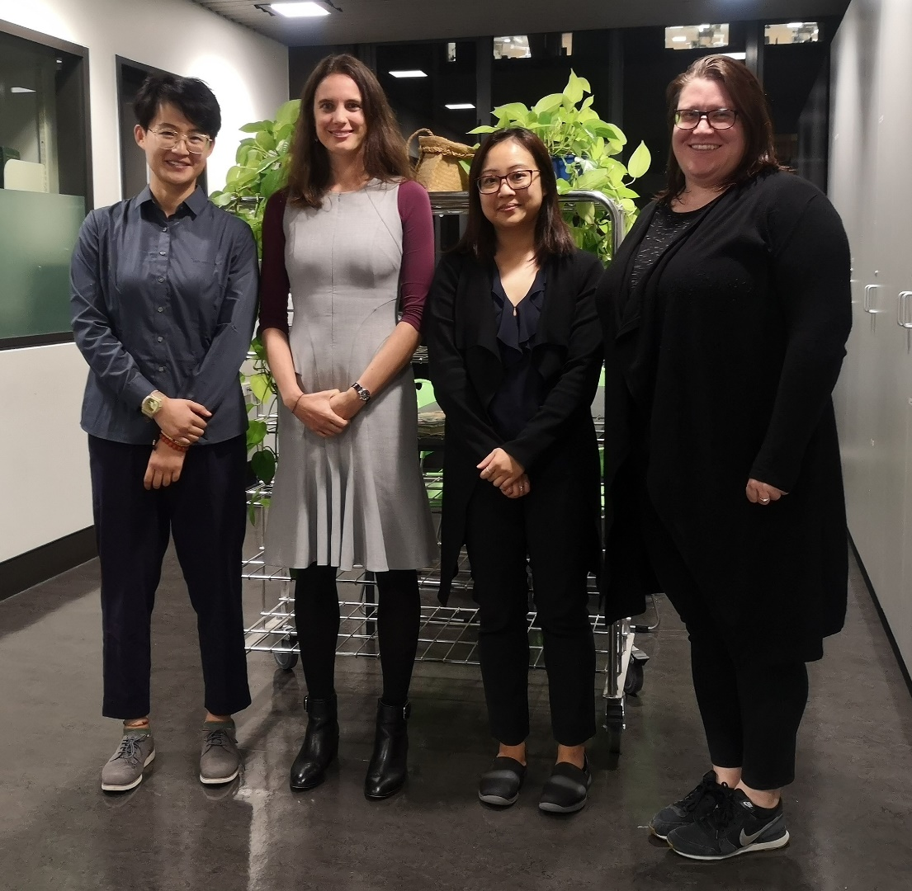


Acknowledgements
David Musson
Sarah-Jane Paine
Subhajit Konar
Zhenqiang Wu
Greg Gamble
Emma Buckels
Ian Reid
Roger Harris

