Slide 1

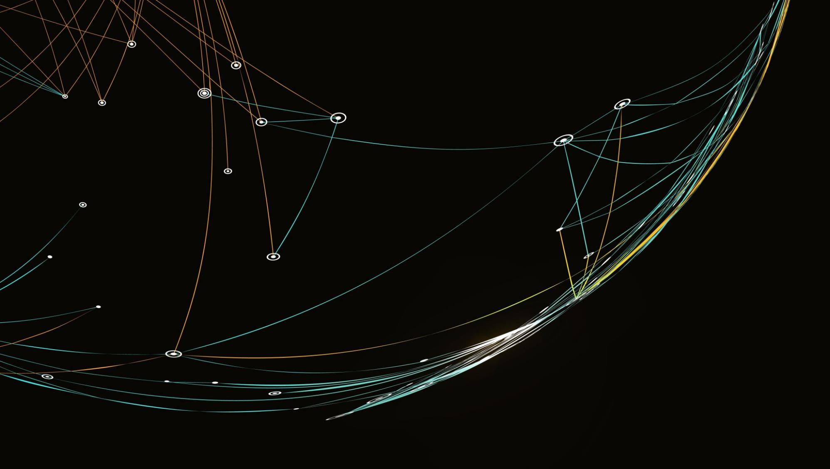
Bone health of Maori/Pacific patients (CMH)
ANZFFR audit
May 2022- January 2023
Sunita Paul
Priya Singh
Amy Joseph
Rashika Chandra

Slide 2
Osteoporosis and Fragility Fracture (FF)
Osteoporosis is porous bones and results in fragility fractures.
Fragility fracture are fractures resulting from low trauma such as fall from a standing height
Hip fractures are the most serious FF
Secondary fracture prevention is crucial to reduce future FF

Slide 3
ANZ Fragility Fracture Registry (ANZFFR)
ANZFFR: Joint venture between Australia and New Zealand
Live in April 2022 in New Zealand
Aims: Identify, Investigate, Inform, Intervene, Integrate and Quality of FLS performance
CMH: Started entry into the registry in May 2022
Total : 1200 patients from May 2022 to current

Slide 4
Aim of Audit
Audit from May 2022 to January 2023
CMH Fracture Liaison Service( FLS) aims to identify:
The potential inequity gaps among Maori and Pacific fragility fracture sufferers in comparison to the non-Maori population.
The prevalence of fragility fractures and osteoporosis among Maori and Pacific in CMH.
Number of Maori and Pacific referred for bone density scan, recommended treatment compared to Non-Maori/Pacific.
Number of Maori and Pacific referred to the Strength and Balance Programme.
Outcomes of interventions
Barriers to access
Access to falls and fracture prevention, bone density scan, and treatment.

Slide 5
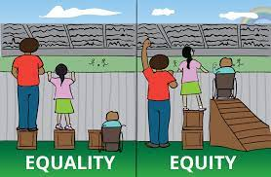
Equity vs Equality
Health Equity
Achieving the same level of health across all populations through fair and responsive resource allocation access to quality of care and health outcomes.
VS
Health Equality
Defined as even allocation and distribution of health and health resources.
Health equality assumes that providing everyone with the same opportunity and resources will result in equal outcomes.
(Te Whatu Ora, 2023)

Slide 6
Population in CM
Data provided from David Xu, CMDHB

Slide 7
CM population with FF aged 50 & over

Slide 8
Hip Fracture incidence by age, gender and ethnicity (Brown ET AL., 2007)
Annual Female hip fracture incidence between 2003-05 by age band
and ethnicity (per 10,000)
Age Group European Maori Pacific Asian
50-54 1.19 1.58 0.64 1.06
55-59 3.28 2.15 3.31 2.19
60-64 5.81 7.18 4.55 3.85
65-69 12.11 8.18 2.90 9.62
70-74 27.76 14.02 20.83 20.29
75-79 65.43 39.06 34.38 44.74
80-84 132.80 84.85 70.59 109.52
85-89 242.44 153.33 150.00 150.00
90+ 359.16 200.00 100.00 250.00
Annual Male hip fracture incidence between 2003-05 by age band
and ethnicity (per 10,000)
Age Group European Maori Pacific Asian
50-54 1.99 1.39 1.28 1.53
55-59 3.95 3.05 1.72 0.00
60-64 4.39 7.14 3.61 0.84
65-69 8.11 8.39 10.34 5.94
70-74 15.52 12.09 21.05 9.38
75-79 35.73 22.92 13.64 25.00
80-84 82.30 60.00 33.33 50.00
85-89 158.21 66.67 66.67 100.00
90+ 264.12 100.00 * 33.33

Slide 9
Osteoporotic fractures by gender, age group and fracture site (PAUL ET AL., 2007)
Total projected osteoporotic fracture incidence in 2007
Men 50–54 55–59 60–64 65–69 70–74 75–79 80–84 85 + TOTAL
Hip 29 46 45 68 95 173 266 384 1106
Vertebra 1687 1001 953 751 1191 1429 1616 1775 10405
Other 2513 4192 1411 2048 1604 1654 3506 3476 20406
TOTAL 4229 5239 2410 2867 2890 3257 5389 5636 31917
Women 50–54 55–59 60–64 65–69 70–74 75–79 80–84 85 + TOTAL
Hip 17 41 62 103 179 382 624 1289 2697
Vertebra 865 888 1304 1458 2128 3140 2693 5114 17590
Other 2059 2486 2101 2727 2780 4557 4759 10681 32151
TOTAL 2941 3415 3467 4288 5086 8079 8077 17084 52437
TOTAL 50–54 55–59 60–64 65–69 70–74 75–79 80–84 85 + TOTAL
Hip 46 87 107 171 274 555 890 1673 3803
Vertebra 2552 1890 2258 2209 3319 4569 4309 6889 27994
Other 4572 6678 3512 4775 4384 6212 8266 14157 52556
TOTAL 7170 8654 5877 7155 7977 11336 13465 22720 84354

Slide 10
Common Types of Fractures in CM
Spine 33
Ankle 24
Hips 15
Wrist 15
Ribs 13
Humerus 08
Pelvis 02
Tibial Plateau 02

Slide 11
Total number of FF May 2022-Jan 2023
Total Patients:997
Non Maori/Pacific: 878 (88%)
Maori/Pacific: 119(12%)
Maori: 61 (51%)
Pacific: 58 (49%)

Slide 12
Prevalence Difference in Gender with FF
Non-Maori with FF 878
Female 634 72%
Male 244 28%
Maori/Pacific FF 119
Female 78 66%
Male 41 34%

Slide 13
*DEXA order vs Done
Treatment recommended vs Started
Non Maori/Pacific
Maori/Pacific
 | Total 876
DXA ordered | 410
DXA done | 171
 | 41%
Treatment Recommended | 283
Treatment Started | 184
 | 65%
 | Total 119
DXA ordered | 69
DXA done | 27
 | 39%
Treatment Recommended | 43
Treatment Started | 19
 | 44.2%

Slide 14
Possible reasons for treatment not started
Maori / Pacific
Non Maori/pacific
2.5% Still A/W GP to start
1.8% Impaired renal function
3 Declined
5 (2.5%) Deceased
1 DNA
3.9% Still A/W GP to start
1% Impaired renal function
8 Declined
3 (0.34%) Deceased
0 DNA

Slide 15
Mortality appears almost 3x in Maori/Pacific patients compared to Non Maori patients

Slide 16
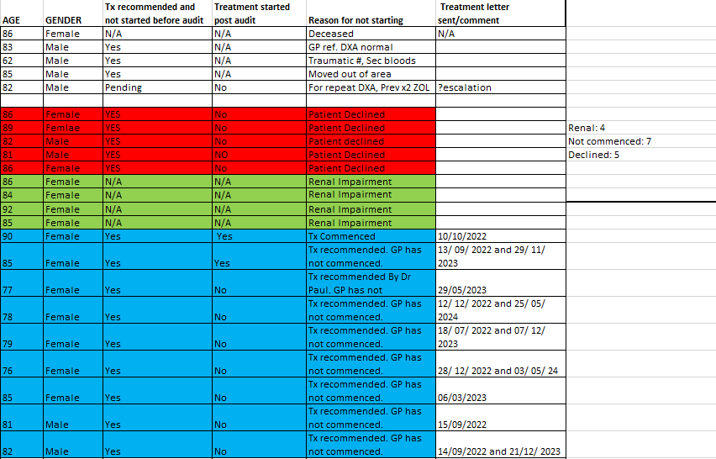

Slide 17
Reason for treatment not starting in the Maori/Pacific Population
AGE | GENDER | Tx Recom | Tx started | Reason | Comment
86 | Female | YES | No | Patient Declined | Client is assessed as PHLOC now. GP has disucssed IV ZOLE with the daughter who has declined as not wanting further treatment
89 | Femlae | YES | No | Patient Declined | The patient declined after discussing with GP that she does not want to commence Bisphosphonate therapy
82 | Male | YES | No | Patient declined | The patient declined treatment as she is planning to return to the island and does not wish to commence on treatment.
81 | Male | YES | NO | Patient Declined | The patient declined treatment despite multiple discussions in the hospital and FLS as he does not wish to commence the treatment for bone protection
86 | Female | YES | No | Patient Declined | Family and patient opted for Cholecalciferol only and declined any other treatment.
 | Follow up on Tx recommended. GP has not commenced.
Age | Gender | Phone follow up on 30/ 05/ 2022 | Outcome
77 | Female | Uncontactable | Follow up letter sent to GP and the patient
78 | Female | Uncontactble | Follow up letter sent to GP and the patient
79 | Female | Uncontactable | Follow up letter sent to GP and the patient
82 | Male | Uncontactable
76 | Female | Patient contacted | Follow up letter sent to GP and the patient
85 | Female | Patient contacted | Follow up letter sent to GP and the patient
81 | Male | Patient contacted and needs to speak to the daughter

Slide 18
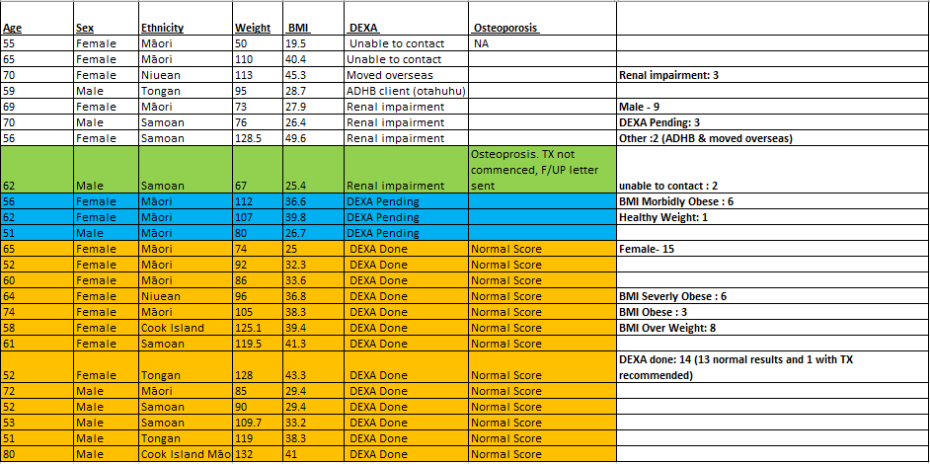
Sub-Analysis of ankle fractures among Maori/Pacific patients

Slide 19
Referred to Strength and Balance
1% Maori/Pacific patients
2% Non Maori

Slide 20
Potential Inequity Identified
No inequity identified from FLS point of view.
HOWEVER
Underlying issues of patients
Increased Co morbidities
Contra-indications to treatment
Renal impairment
High mortality in Maori Pacific group

Slide 21
Access Barriers for DXA scans and treatment
Transportation
Family support
Parking
Mobility
Health Literacy
Language barrier (while booking for appointments)
Funding (Denosumab)

Slide 22
Some impacts of Social Determinants, burden of illness, treatment and capacity issues on accessing appropriate care
Income – impacting on affordability
Health literacy
Covid 19
Support
Other comorbidities

Slide 23
Simply providing the information is not sufficient.
Create Conversation that is PCCC, culturally safe, PSDM and MDM
Collaborate care with patients and Whanau. Tailored/Personalised to individual
Understand and address patient workload (burden of illness, treatment and life) and capacity
Reduce Waitlist
Community GP services require more education to be able to identify and intervene.
Accurate data entry into the registry
Areas to improve

Slide 24
References
Compston, J. (2004). Osteoporosis. In D. A. Warrell, E. J. Benz, T. M. Cox & J. D. Firth (Eds.), Oxford Textbook of Medicine (4th Edition ed., Vol. 3).
Brown, P., McNeill, R., Radwan, E., & Willingale, J. (2007). The burden of osteoporosis in New Zealand 2007-2020. Centre for Health Services Research and Policy.
Te Whatu ora. (2023). A fair system priorities equity. Retrieved 1/5/2023. Health Equity (hanz.health.nz)
Xu, D. (2023). Senior IT analyst, CMDHB.
Chan, W.C. (2023) Population Health Strategy & Investments team. CMDHB

Slide 25
Thank You to everyone who has contributed to this audit
CMH FLS team
Dr Sunita Paul for her expert advice and guidance
Sumitha our manager
ACC and Osteoporosis NZ for your support
Nicola and Stewart from the ANZFFR
FFNNZ

