Slide 1
Prevention. Care. Recovery.
Improving New Zealander’s quality of life
Richard van der Jagt
ACC Partnered Delivery Manager
10 May 2023
Notes:
Pepeha and intro

Slide 2
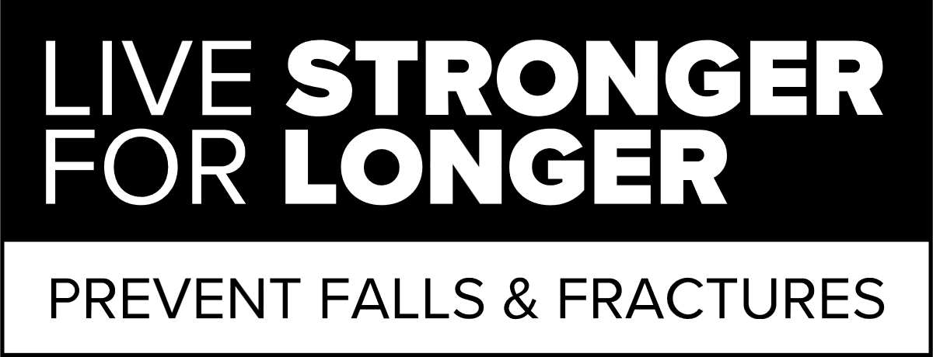
Live Stronger for Longer
ACC receives approximately 2 million claims per year
Falls are the most common cause of injury in New Zealand
Falls and fractures cost ACC ~$294m in FY22
The true costs of falls is greater
LSFL is a national movement full of practical information and advice on how to stay active
Community Strength and Balance
Fracture Liaison Service (FLS)
Notes:
ACC receives approximately two million claims pa - ~5.5k claims per day
Falls are the most common cause of injury in NZ - 39 percent of all ACC claims
750,000 claims for falls. - These injuries came at a cost of $1.8 billion to help people recover – over the past six years was $8.6 billion
As we age falling is one of the most common causes of injury and the consequences of a fall can be devastating
For 65+ population its quite startling
Falls are the most common and costly cause of injury in people aged 65 years and older
Every year Over 65 – 1 in 3 people injures themselves in a fall, - Over 80 - 1 in 2 injury themselves.
Falls and fractures cost ACC ~$294m in FY22
Population forecasts indicate that in the absence of interventions, ACC should expect the present value cost of older adult falls and fractures to increase to at least $460m p/a by 2023
True cost of falls is greater AND cost often result in a loss of independence and wellbeing and can effect not only the injured person but also the whanau that supports them
LSFL
LSFL is a national movement full of practical information and advice on how to
stay active,
well and independent for over 65s
and those caring for over 65s
LSFL captures the essence of positive ageing. It celebrates independence while acknowledging the physical reality of getting old.
LSFL unites the efforts of the entire health system
For ACC
our LSFL programme aims to prevent falls in older people, to allow them to remain confident, healthy and independent in their homes and community.
There is compelling evidence of effective interventions to reduce falls and prevent fractures in this population group.
and we want to talk to 2 of these today
Community Strength and balance – to prevent falls
CSB has been Operating for 7 years and we have some good results
17 lead agents – across 20 regions
Run about 1,750 classes and attendances are in the order of 20,000 per quarter
Clinical research shows simple body movements improve balance and reduces risk of falls by almost 30%.
CSB has been operating for 7 years and we have some good results
But - Still some issues and barriers for people undertaking classes
- definitely socialisation plays a part
- some stigmas associated

Slide 3
Digital balance training
Scalable, low cost, anywhere, adaptable product
Extensive RFP process
Decision to trial with Nymbl
Pilot ran from August 2020 – September 2021.
15,363 Nymbl users completed over 300,000 training sessions and over 100,000 education sessions.
A total of 87 percent of users said they were likely to recommend the Nymbl balance training programme to a friend.
Notes:
ACC is focused on building partnerships to look at new and innovative ways to prevent, reduce and effectively treat injuries
We knew there is a stigma to class-room based S&B + COVID showed us an opportunity
We sought to understand whether a digital online platform (an app) could be an effective complement to the delivery of falls prevention management programs
Something you could do in your own time at your own place that has proven benefits
In September 2021 ACC released the RFP which identified three possible suppliers.
All three suppliers demonstrated a strong research and evidence capability built into their solutions that is shown to reduce the falls risk in older adults.
Nymbl Science was eventually chosen as the preferred candidate as it had the proven ability to reach the target audience and to achieve a positive return on investment.
Trial between August 2020 – September 2021.
More than 15,000 people aged 55 years and over registered with the trial of Nymbl’s digital balance app.
Those users completed over 300,000 training sessions and over 100,000 education sessions.
A total of 87 percent of users said they were likely to recommend the Nymbl balance training programme to a friend.
The research shows that 71 percent of Nymbl users who used the app for 21 days have improved their 30 second sit to stand balance test.
IMPORTANLY our evidence showed that people who used were having a reduced claim rate against the same cohort who didn’t use Nymbl

Slide 4
Pilot survey results
Subjective outcomes
52% reported “My walking is more steady”
Fear of falling is a primary indicator of future falls and disability, improved belief and performance is crucial for success.
58% reported “my balance has improved”
79% reported “I am confident I will not lose my balance around the house”
Notes:
Data supplied by Nymbl shows that the app has a positive impact on the user’s balance:

Slide 5
What is Nymbl?
Dual Tasking approach
combining simple body movements
with fun brain games (trivia)
Prepares you for these real-life experiences and distractions by combining simple body
Self-paced digital application that improves balance in 10 minutes per day
Designed for 65 years – but we are providing to anyone over 50 years
Notes:
Research shows that falls happen when we are distracted, not when we are focused. Nymbl helps prepare you for these real-life experiences and distractions by the unique Dual Tasking Approach - to challenge both the brain and body - which has already shown success overseas in reducing falls and fractures
Nymbl’s physical component involves
simple body movements that you do in your daily routine (such as raising your foot over a rug).
with fun brain games (trivia)
Falling is a brain challenge as much as it is a physical challenge
The combination of cognitive and physical challenges that is the key to Nymbls approach
self-paced digital application
Because NYMBL is personalised it
adjusts to your physical ability and level of progress,
so it’s tailored for each user,
so you only progress when you’re ready to move on to a slightly more challenging –
“By investing 10 minutes a day, a few times a week, in the comfort of your own home, you can improve your balance and maintain your independence and confidence.”

Slide 6
Notes:
Video duration: 1.28mins

Slide 7
Getting started with Nymbl
Notes:
No special equipment needed except a smartphone or tablet with internet access.
The Nymbl app is available for Apple and Android devices and can be downloaded for free from:
Apple App Store
Google Play Store
Login in with your:
First name
Last name
Date of birth
Enter other personal information (e.g. gender, ethnicity etc). Nymbl collects personal information and engagement data within the Nymbl app. Does not sell or share data with any advertisers or marketers.

Slide 8
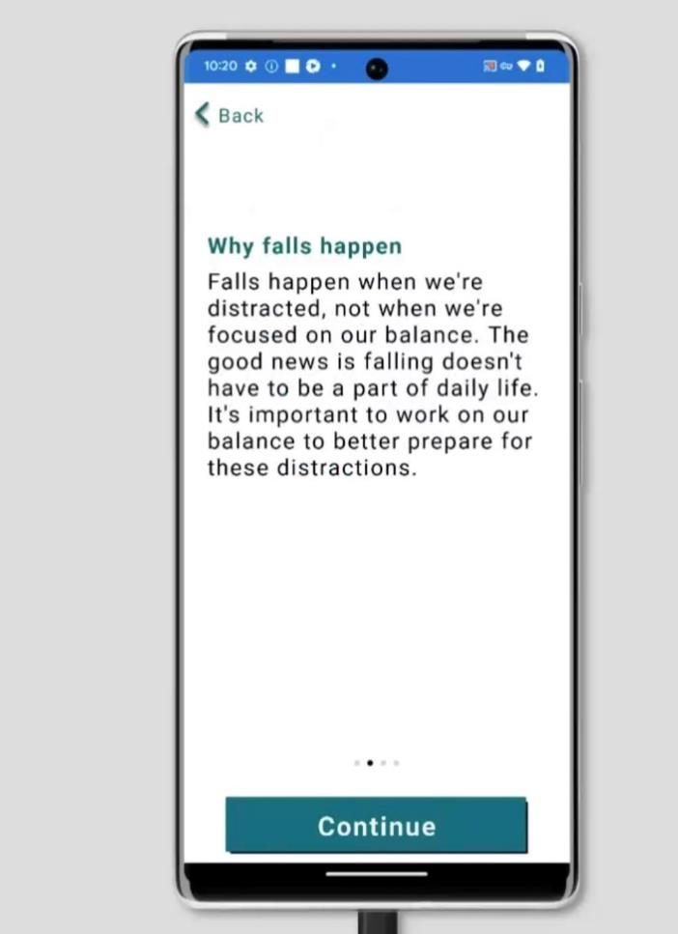
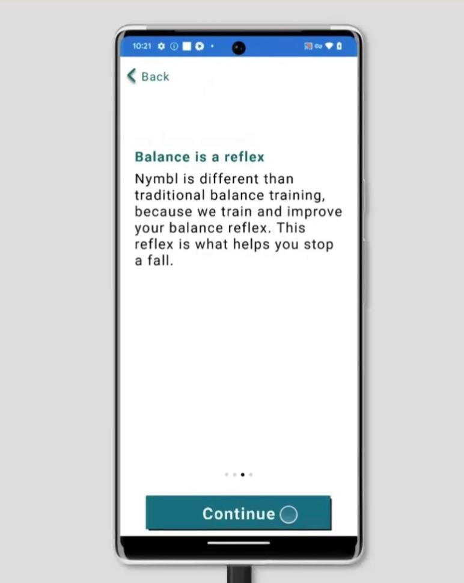
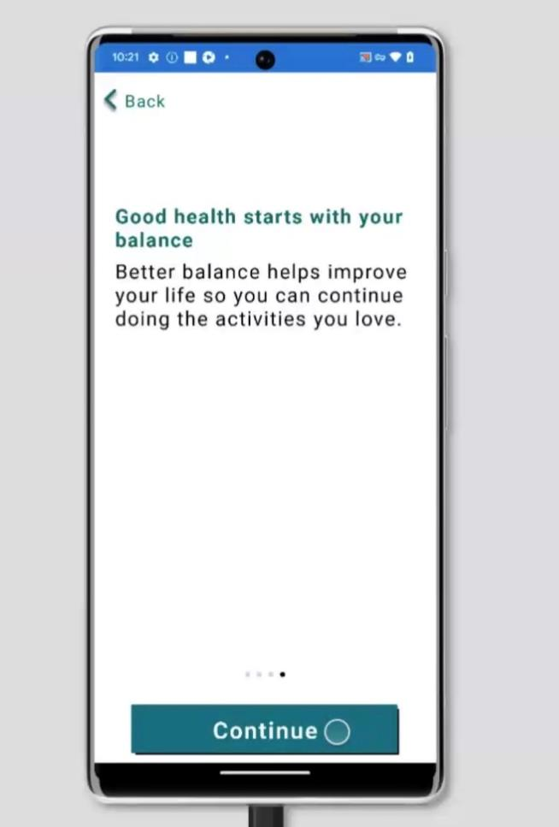
Notes:
The next section covers a bit of background on:
How Nymbl works
Why falls can happen
Balance is a reflex
Good health starts with your balance

Slide 9
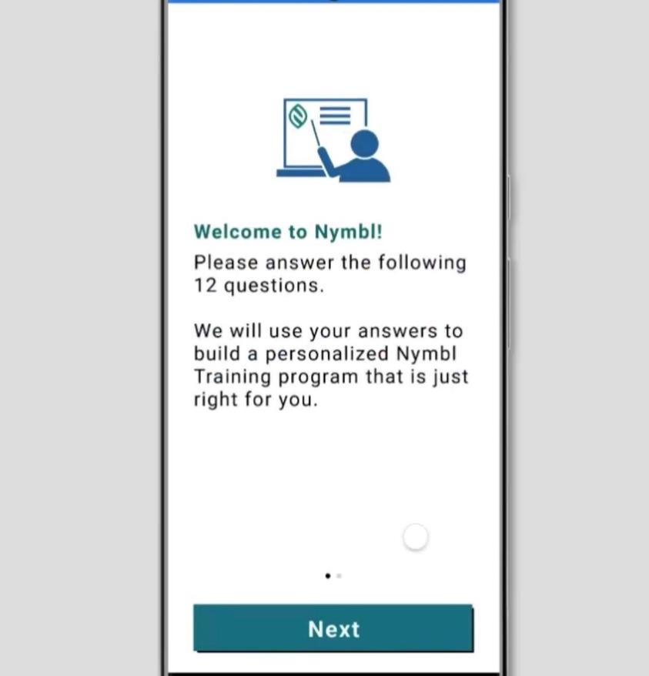
Getting started with Nymbl
Notes:
Nymbl will prompt users to complete a 12 question survey to assess your needs and personalise the experience for you.
An example of these questions is above.
More information about how Nymbl assigns levels is found in the How Do Levels Work in Nymbl PDF
The first session involves an exercise, then a game, and finally doing them at the same time.

Slide 10
Launch
The campaign over this first month has been very successful – reaching 51% of overall FY target.
Exceeding week 4 performance of the pilot launch in week 2 (8,490 downloads by week 2 vs. 8,258 downloads week 4 of pilot).
97% of people have used the app for a training session.
Users are skewed female (61.89%).
Newspapers are the most common referral source so far, followed by TV and social media.
We have a further programme of work to continue the visibility of Nymbl over the coming months.

Slide 11
Resources
Nymbl FAQs document
How Do Levels Work in Nymbl
Nymbl Step by Step Beginner’s Guide
A5 flyers
Posters

