Slide 1
Fracture Fest 2023 Nicola Ward & Denise MacKenzie
Case Studies

Slide 2
Background
BOP FLS since 1st July 2022 assessed 164 patients with vertebral fractures meeting our criteria.
Plenty to choose from
Look at two case studies

Slide 3
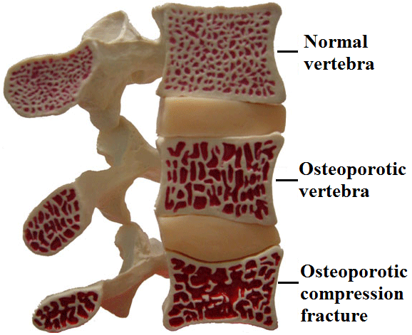
Vertebra anatomy
Notes:
Looke dat this today already

Slide 4
Case Study 1
Admitted to medical ward- Male, Māori, 52yrs, had seizure, c/o back pain, CT Scan showed # T6,T8.
Previous old # T7, Smoker both cigarettes and cannabis, alcohol abuse. Poor diet.
(RISK FACTOR AFTER RISK FACTOR)
What did FLS do?
Notes:
Read out slide
DEXA, Bone Health AX on ward, GP liaison

Slide 5
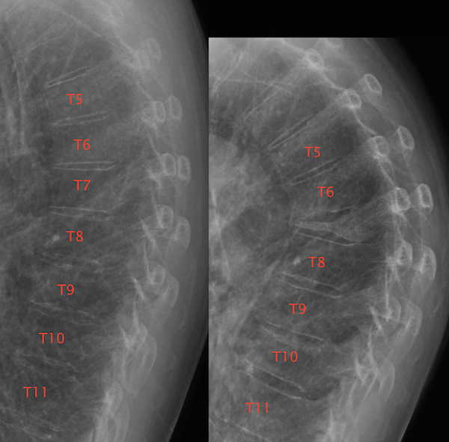

Slide 6
Case Study 1
Liaised with GP and patient agreeable to DXA scan
T-score -3.3 in spine
Advised treat with IV Zoledronate, Vit D and calcium tabs
Aware patient could not fund this cost
Discussions with GP and gave to patient for free
Pre- FFR/FLS funding – no follow-up ? If had 3 infusions.

Slide 7
Osteoporosis of Vertebra
Two case Studies
Two different outcomes
Points to think about:
What significance does the information in the DXA report have?
How prescriptive does FLS need to be to be effective?
Notes:
Barriers to treatment DEXA results -> variation in recommendations from reporting entity -> is there a way to standardize this?
Patient beliefs, GP beliefs and experiences and knowledge

Slide 8
Patient 1 Rachel
Rachel
60 year old female
Well women's check and GP suggested DEXA
No Risk Factors for Osteoporosis
No Falls or Fractures
BMI 27.7
Notes:
Menopause age 55 years 1 of 4 half sisters had osteoporosis BMI 27.7
Non smoker Minimal ETOH Mildly overweight Sedentary job No parental history of hip #

Slide 9
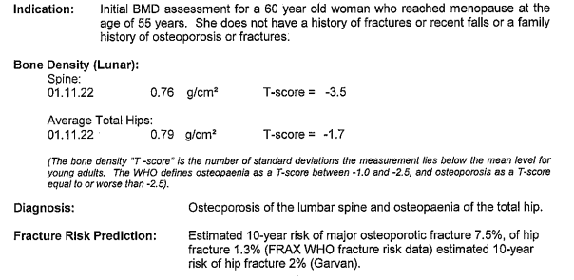
BMD Results - What should we do?
Notes:
Screening bloods all normal
Why wouldn’t I have treatment
Why would i wait to have a fracture

Slide 10
Disbelief
Rachel was shocked at outcome and didn't believe the results
GP discussed with DXA provider who offered another scan on different scanner with different technician for free
Results were the same!

Slide 11
DXA Report Recommendation

Slide 12
Case Study 2
59yrs old female, full time early childhood teacher.
Lifted her mothers wheelchair into the car. Immediate back pain.
ED review Xray showed L1 compression fracture
Epilepsy on Tegretol.
FLS case found
What did FLS do?
Telephone consult- several
DEXA
Bisphosphonates are considered first line drug therapy for Osteoporosis, and we have: [inserted if Alendronate/Risedronate/Zoledronate(bisphosphonates) are ticked]
□ Commenced this patient on Alendronate 70mg/weekly Orally: Suggested treatment duration of ~ 5years followed by a drug holiday of 1-2 years
□ Recommended this patient to follow up with you to discuss and commence treatment such as Alendronate 70mg/weekly Orally: Suggested treatment duration of ~ 5years followed by a drug holiday of 1-2 years [inserted if Alendronate ticked….there will different versions for Risedronate and Zoledronate]
□ Creatinine Clearance (Cockroft Gault) _[insert] _ml/min Creatinine Clearance is recommended to be ≥35mL/min.
□ Please check serum P1NP after 6 months of treatment check absorption/compliance.
If greater than 35ug/l this suggests either an absorption or adherence problem. A treatment review is indicated, and consideration given to a switch to IV Zoledronate is recommended (unless there are contraindications).
□ We have discussed treatment options and have provided the patient with verbal and written information on the medication, detailing the benefits, side effects and method of administration.
□ Next DXA is due……………[Free Txt]……………………………………………..
□ A copy of this treatment plan has been sent to the patient for their records. [Part of base template(bisphosphonates) but only boxes ticked will show up in final document]

Slide 13
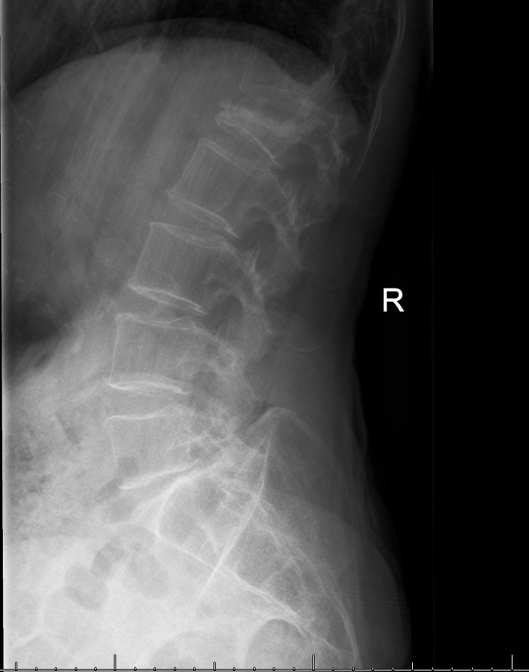

Slide 14
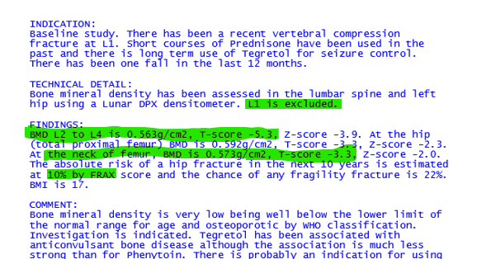
Case Study 2
T-score -5.3 on average! in spine
Notes:
Lowest BMD we had at the time

Slide 15
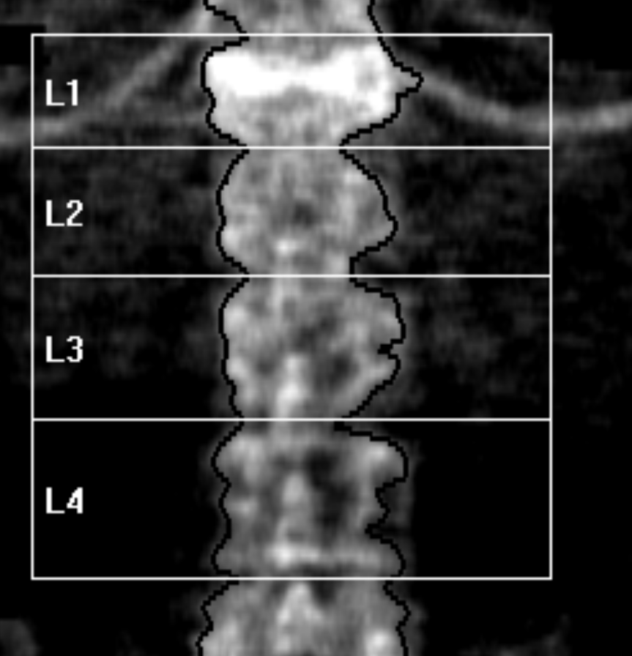
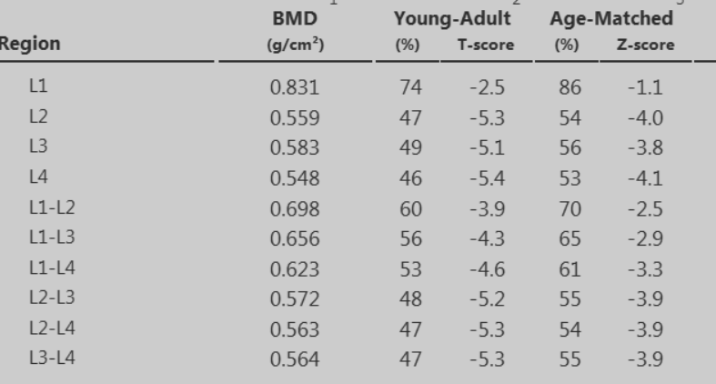
Case Study 2
Bisphosphonates are considered first line drug therapy for Osteoporosis, and we have: [inserted if Alendronate/Risedronate/Zoledronate(bisphosphonates) are ticked]
□ Commenced this patient on Alendronate 70mg/weekly Orally: Suggested treatment duration of ~ 5years followed by a drug holiday of 1-2 years
□ Recommended this patient to follow up with you to discuss and commence treatment such as Alendronate 70mg/weekly Orally: Suggested treatment duration of ~ 5years followed by a drug holiday of 1-2 years [inserted if Alendronate ticked….there will different versions for Risedronate and Zoledronate]
□ Creatinine Clearance (Cockroft Gault) _[insert] _ml/min Creatinine Clearance is recommended to be ≥35mL/min.
□ Please check serum P1NP after 6 months of treatment check absorption/compliance.
If greater than 35ug/l this suggests either an absorption or adherence problem. A treatment review is indicated, and consideration given to a switch to IV Zoledronate is recommended (unless there are contraindications).
□ We have discussed treatment options and have provided the patient with verbal and written information on the medication, detailing the benefits, side effects and method of administration.
□ Next DXA is due……………[Free Txt]……………………………………………..
□ A copy of this treatment plan has been sent to the patient for their records. [Part of base template(bisphosphonates) but only boxes ticked will show up in final document]

Slide 16
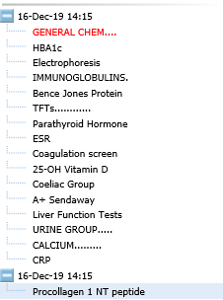
Case Study 2
Secondary bloods – nil concerns
Bone Clinic given age and low BMD
Advised treat with IV Zoledronate annually x3,
Vit D and calcium tabs
Notes:
Tell the lady ongoing sad story, # sternum, cardiothoracic turned down as so osteoporotic, at this point had x2 aclasta.

Slide 17
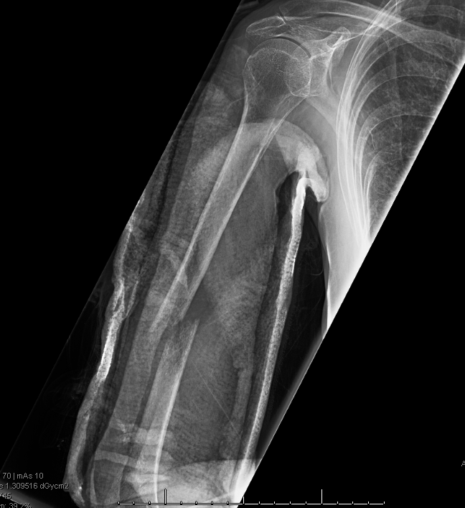
Case Study 2
Notes:
Then a few months later did this to her arm flicking the duvet over
Diagnosed with Lymphoma

Slide 18
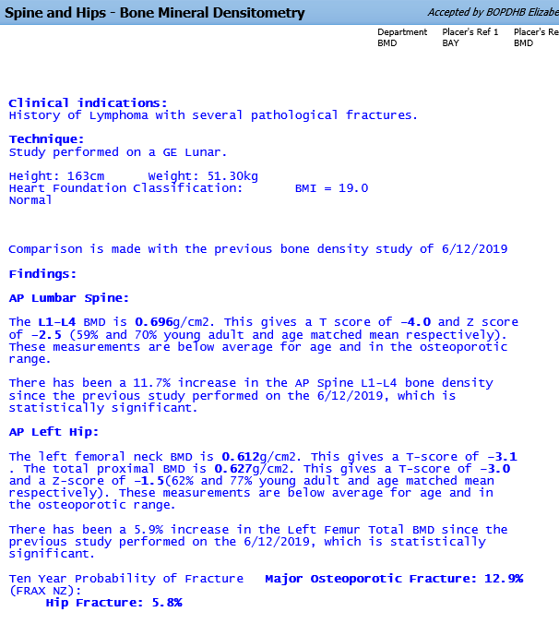
Case Study 2
2022 DEXA
Bisphosphonates are considered first line drug therapy for Osteoporosis, and we have: [inserted if Alendronate/Risedronate/Zoledronate(bisphosphonates) are ticked]
□ Commenced this patient on Alendronate 70mg/weekly Orally: Suggested treatment duration of ~ 5years followed by a drug holiday of 1-2 years
□ Recommended this patient to follow up with you to discuss and commence treatment such as Alendronate 70mg/weekly Orally: Suggested treatment duration of ~ 5years followed by a drug holiday of 1-2 years [inserted if Alendronate ticked….there will different versions for Risedronate and Zoledronate]
□ Creatinine Clearance (Cockroft Gault) _[insert] _ml/min Creatinine Clearance is recommended to be ≥35mL/min.
□ Please check serum P1NP after 6 months of treatment check absorption/compliance.
If greater than 35ug/l this suggests either an absorption or adherence problem. A treatment review is indicated, and consideration given to a switch to IV Zoledronate is recommended (unless there are contraindications).
□ We have discussed treatment options and have provided the patient with verbal and written information on the medication, detailing the benefits, side effects and method of administration.
□ Next DXA is due……………[Free Txt]……………………………………………..
□ A copy of this treatment plan has been sent to the patient for their records. [Part of base template(bisphosphonates) but only boxes ticked will show up in final document]
Notes:
Then a few months later did this to her arm flicking the duvet over
Diagnosed with Lymphoma look at her DEXA results

Slide 19
Merle
2013
55-year-old woman Merle
Well woman check with GP
No falls or fractures
Menopause @ 51 yrs short trial of HRT
Slender build BMI 21
Runner
Melanoma 15 years prior

Slide 20
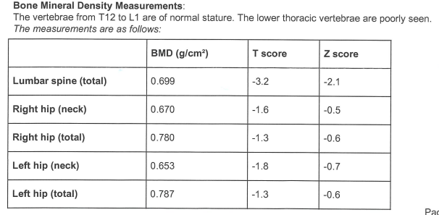
BMD RESULTS

Slide 21
DXA report what should we do?
Notes:
Given this information What should we do?
Should she be offered treatment
Should she wait?
Who’s responsibility is it for her to be followed up?

Slide 22
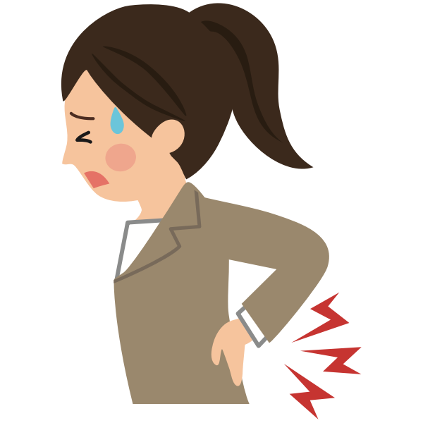
Fast Forward to 2021
No treatment discussed or commenced
No DXA follow up arranged
Patient states she was “unaware of the significance of her results and what the long term outcome could be”
Merle now aged 63 years old
Mid 2021 she developed severe debilitating back pain
Unable to go running or walking
Quality of life diminished
Repeat DXA
Orthopaedic Surgeon told her she had the bones of and 80 year old woman

Slide 23
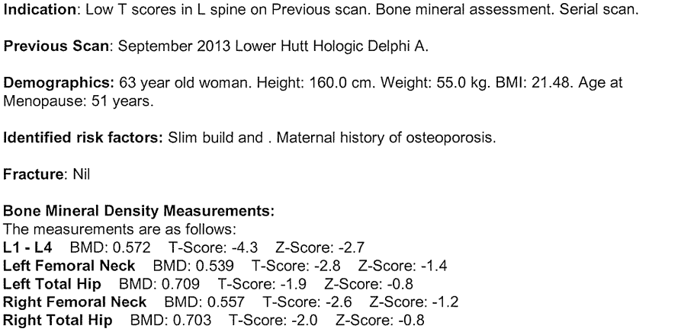
Updated DXA

Slide 24
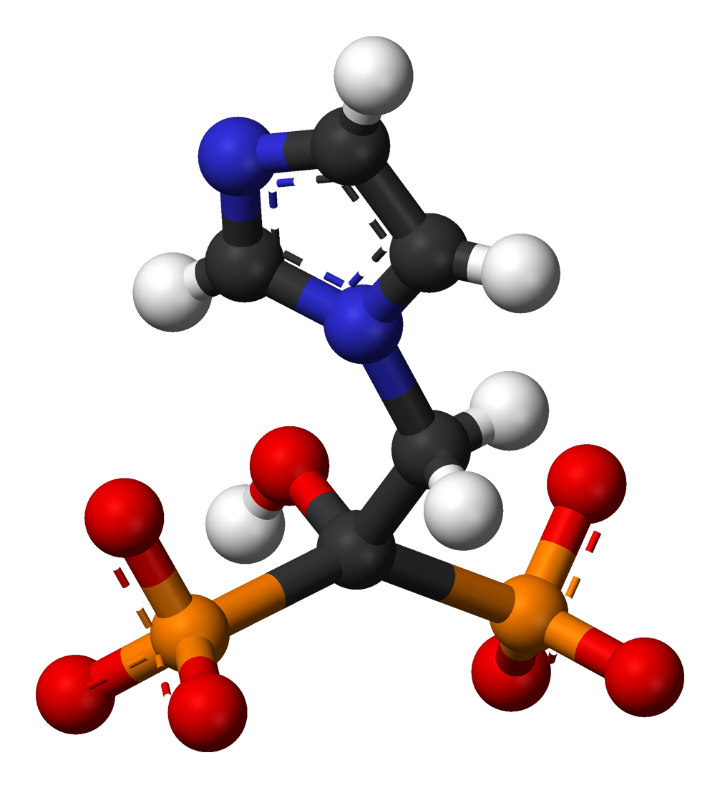
What should we do now?
Refer to Endocrinologist
Screening blood tests
Treatment options
Teriparatide?
Bisphosphonates?

Slide 25
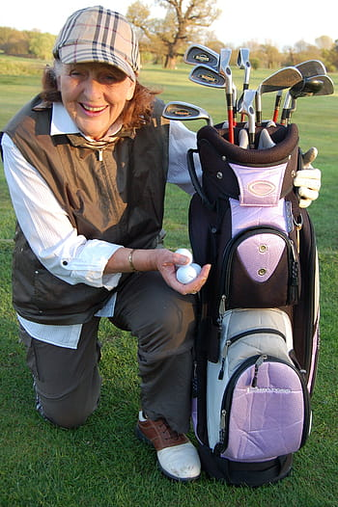
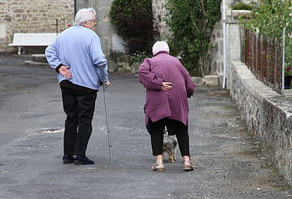
Where do we want to end up?
V

