Slide 1
Frailty and Dementia
Lara Hitchcock, RN,
Memory Assessment Clinic
Fracture fest – education day
9th May 2024

Slide 2
Overview of session
What is dementia?
How are dementia and frailty connected?
To treat or not to treat, ethical considerations?

Slide 3
Dementia in New Zealand
In 2021 around 70,000 Kiwis were living with dementia mate wareware. This is set to rise to approximately 170,000 by 2050.
4 out of 5 Kiwis know or have known someone living with dementia.
Women have around a 30% higher risk than men of developing dementia.
The total cost of dementia is now around $2.5b (1/2 of which is ARC) and this amount is predicted to double by 2050.
Dementia numbers are increasing at a faster rate among Māori, Pacific peoples and Asian populations.
Notes:
Ma’u E, Cullum S, Yates S, Te Ao B, Cheung G, Burholt V, Dudley M, Krishnamurthi R, Kerse N. Dementia Economic Impact Report 2020. Auckland, New Zealand: University of Auckland; 2021
26 years 1.4% total population and 8% of 65 +
YOD Māori (19.0%), Pacific (18.0%), and Asian (16.8%) populations compared to Europeans (8.0%), dementia amongst Māori (4,300), Pacific (1,930) and Asian (4,800) populations will almost triple to 12,030, 5,450 and 17,990 respectively in 2050.
Ma’u et al 2021

Slide 4
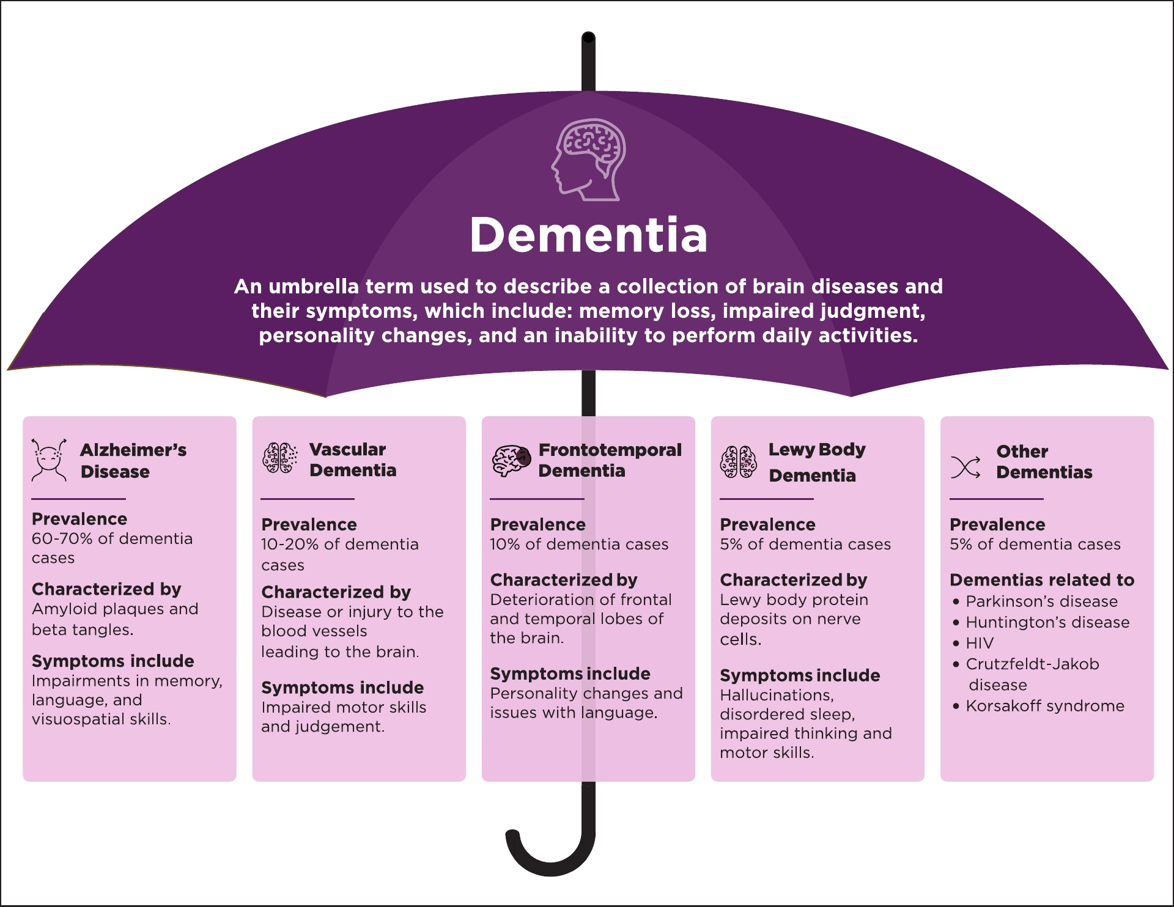
https://www.gardensofsuncity.com/explaining-the-umbrella-of-dementia/
Notes:
CBS, PSP chronic, traumatic encephalopathy, or CTE

Slide 5
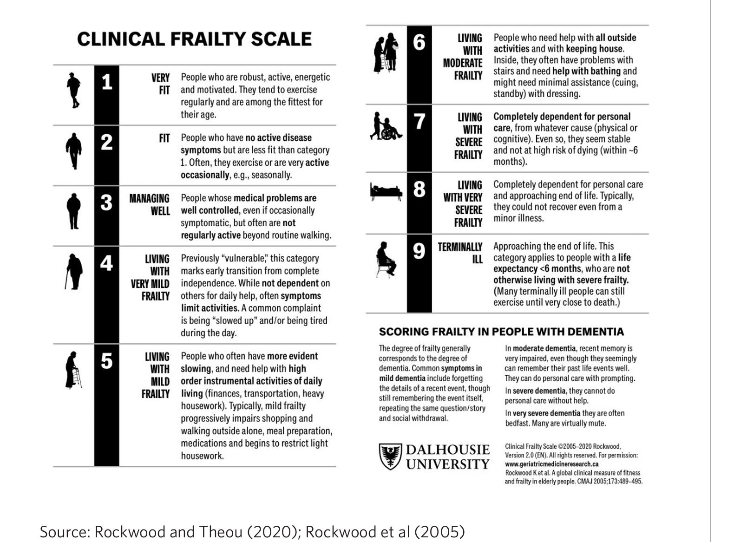
Notes:
Frailty | Te wairuhi (Frailty care guides 2023) 2023

Slide 6
Dementia, frailty and falls
Frailty and dementia are most common in people aged 85 years and older.
Those with frailty are at a 4 x higher risk of dementia.
But cognitive impairment could be a clinical feature of frailty.
AND
Dementia increases the risk of falls by 2–3 times.
25% of people with dementia have had at least 1 fracture, compared to 7% of those without dementia .
Those with dementia are less likely to recover pre fracture function following a fracture and increased dependence compared to those without dementia.
Notes:
Considering that frailty is a modifiable syndrome in middle age, its early detection and treatment might represent a target for prevention or delayed onset of neurodegenerative diseases, including dementia. Petermann-Rocha, F., Lyall, D. M., Gray, S. R., Esteban-Cornejo, I., Quinn, T. J., Ho, F. K., ... & Celis-Morales, C. (2020). Associations between physical frailty and dementia incidence: a prospective study from UK Biobank. The Lancet Healthy Longevity, 1(2), e58-e68.
Kulmala, J., Nykänen, I., Mänty, M., & Hartikainen, S. (2013). Association between frailty and dementia: a population-based study. Gerontology, 60(1), 16-21.
Ward, D. D., Ranson, J. M., Wallace, L. M., Llewellyn, D. J., & Rockwood, K. (2022). Frailty, lifestyle, genetics and dementia risk. Journal of Neurology, Neurosurgery & Psychiatry, 93(4), 343-350.

Slide 7
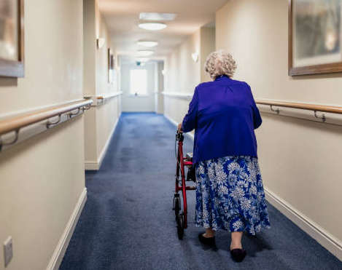
Case study –
Mrs. Smith
iStock image
Notes:
iStock image

Slide 8

To treat or not to treat, that is the question?
Notes:
Those with dementia are less likely to be assessed or offered preventative strategies

Slide 9
Why should preventative treatment be considered for those with dementia?
In one study the mortality rate in people with dementia with a fracture is 20% at 30 days and 50% at one year.
½ of older people with dementia with a fracture require either entry into ARC or a higher level of care compared to a 1/3 of older people with a fracture without dementia.
It is vital to supporting all people including those with dementia to maintain as much independence following a fracture as possible as this is key to maintaining their quality of life.
Notes:
Dementia overview | Tirohanga whānui o te mate wareware (Frailty care guides 2023) 7/2/24
Singh, I., Duric, D., Motoc, A., Edwards, C., & Anwar, A. (2020). Relationship of prevalent fragility fracture in dementia patients: three years follow up study. Geriatrics, 5(4), 99.

Slide 10
Person centred care
The person living with dementia is more than their diagnosis.
It is important to see the world from the perspective of the person living with dementia.
Remember all people with dementia can experience joy, comfort and meaning in life.
Build and nurture authentic, caring relationships that demonstrate respect and dignity.
Create an environment that allows for comfort.
Ensure whānau/families understand the treatment goals and are able to support the person living with dementia to make an informed choice.
Notes:
Get to know them and support them to uphold their values, beliefs, interests, abilities, likes and dislikes.

Slide 11

Capacity and EPOA’s
'Capacity' is a legal term that means you are able to understand the information necessary for decision making and anticipate the likely outcomes of decisions. The capacity to communicate decisions is also required.
Therefore, if a person is deemed to lack mental capacity, they are unable to make and/or communicate heath decisions or anticipate the likely outcomes of decisions.
You do not necessarily lack capacity just because you have a dementia diagnosis.
An EPOA for Personal Care and Welfare can only be activated when an individual has been assessed and certified by a medical professional as no longer having mental capacity.
Notes:
Alz NZ
Treatment and where they live

Slide 12
BUT
People with dementia still have a right to make their own health decisions, be involved in decisions that affect them and be supported in making decisions.
It is important to discuss the options when it comes to treatments and support so that the person living with dementia can make the best decisions for themself and their family.

Slide 13
In conclusion
It is important to consider preventative treatment for those living with dementia.
Provide the necessary person-centred information to enable the person living with dementia be involved in their treatment plan
It is possible to live well with dementia even in a rest home!!

Slide 14
References
Daltrey, J., & Leaf-Wrght, P. (2023). Frailty care guides| Ngā aratohu maimoa hauwarea (2023 edition).
Kitwood, T., & Brooker, D. (2019). Dementia reconsidered revisited: The person still comes first. McGraw-Hill Education (UK).
Knopp‐Sihota, J. A., Cummings, G. G., Newburn‐Cook, C. V., Homik, J., & Voaklander, D. (2014). Dementia diagnosis and osteoporosis treatment propensity: A population‐based nested case–control study. Geriatrics & Gerontology International, 14(1), 121-129.
Kulmala, J., Nykänen, I., Mänty, M., & Hartikainen, S. (2013). Association between frailty and dementia: a population-based study. Gerontology, 60(1), 16-21.
Ma’u E, Cullum S, Yates S, Te Ao B, Cheung G, Burholt V, Dudley M, Krishnamurthi R, Kerse N. Dementia Economic Impact Report 2020. Auckland, New Zealand: University of Auckland; 2021
Mughal, N., Inderjeeth, A. J., & Inderjeeth, C. A. (2019). Osteoporosis in patients with dementia is associated with high morbidity and mortality:'Findings from a single orthogeriatric unit'. Australian journal of general practice, 48(1/2), 53-58.
Petermann-Rocha, F., Lyall, D. M., Gray, S. R., Esteban-Cornejo, I., Quinn, T. J., Ho, F. K., ... & Celis-Morales, C. (2020). Associations between physical frailty and dementia incidence: a prospective study from UK Biobank. The Lancet Healthy Longevity, 1(2), e58-e68.
Rockwood, K., Song, X., MacKnight, C., Bergman, H., Hogan, D. B., McDowell, I., & Mitnitski, A. (2005). A global clinical measure of fitness and frailty in elderly people. Cmaj, 173(5), 489-495.
Rockwood, K., & Theou, O. (2020). Using the clinical frailty scale in allocating scarce health care resources. Canadian Geriatrics Journal, 23(3), 210.
Singh, I., Duric, D., Motoc, A., Edwards, C., & Anwar, A. (2020). Relationship of prevalent fragility fracture in dementia patients: three years follow up study. Geriatrics, 5(4), 99.
Ward, D. D., Ranson, J. M., Wallace, L. M., Llewellyn, D. J., & Rockwood, K. (2022). Frailty, lifestyle, genetics and dementia risk. Journal of Neurology, Neurosurgery & Psychiatry, 93(4), 343-350.
Xie, C., Wang, C., & Luo, H. (2023). Increased risk of osteoporosis in patients with cognitive impairment: a systematic review and meta-analysis. BMC geriatrics, 23(1), 797.

Slide 15


